Slide 1


FR200L & Wire Drawing Machine
2014.12

Slide 2
Content
Wire Drawing Machine Introduction
FRECON FR200L Series Introduction
FRECON Solution & Application

Slide 3
Wire Drawing Machine Introduction
Principle
Thick Wire
Thin Wire
The thick line pulled to be thin line after a series of moulds

Slide 4
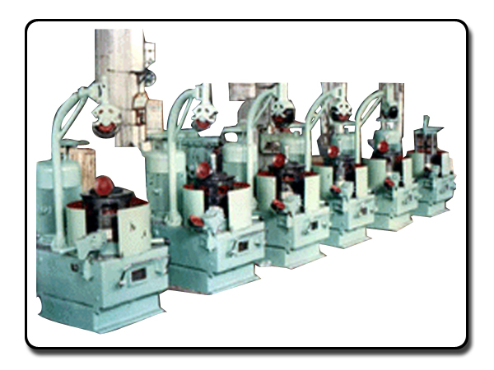
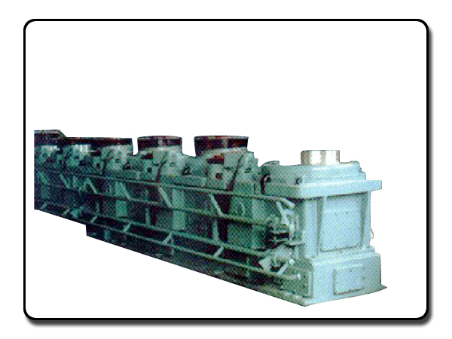
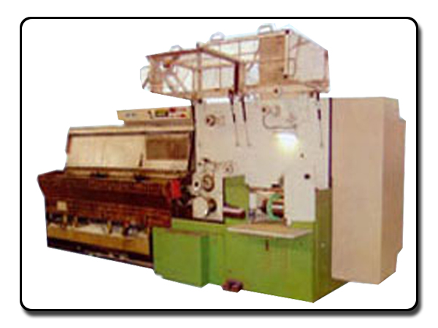
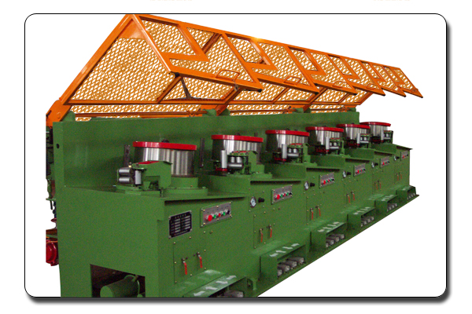
Types of wire drawing machine
Pulley type
Loop/Dancing type
Water tank type
Straight line type

Slide 5
Pulley type
Feature
Simple structure and low cost
To implement a certain tension control by pulley
To stop some drums by manual only
The friction caused damage to steel wire and drum
Low drawing speed

Slide 6
Loop/Dancing type
Feature
Relatively simple structure
With active tensional wheel and fixed wheel
No torsion, high quality steel wire and high drawing speed
No wear

Slide 7
Water tank type
Feature
Wet drawing, cooling, lubrication
Water tank, cone pulley structure
Use tension swing roller to adjust the tension

Slide 8
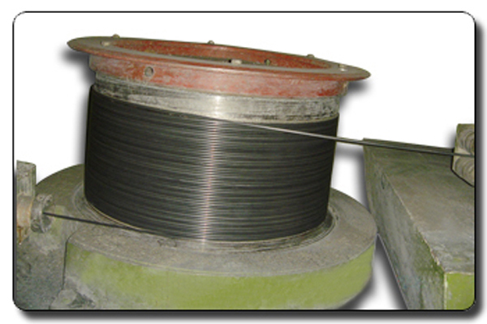
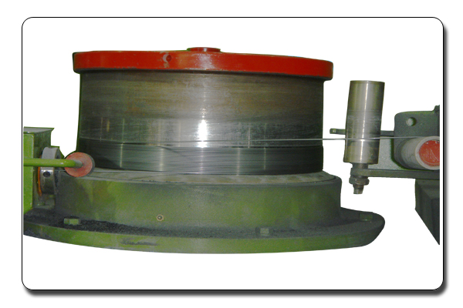
Straight line type
Feature
Dry drawing
Multiple swing rollers, inverters & PIDs
Can adjust the variation caused by
the mould wear

Slide 9
Our Target！！
Pulley type
Our target
Loop/Dancing type
Water tank type
Straight line type

Slide 10
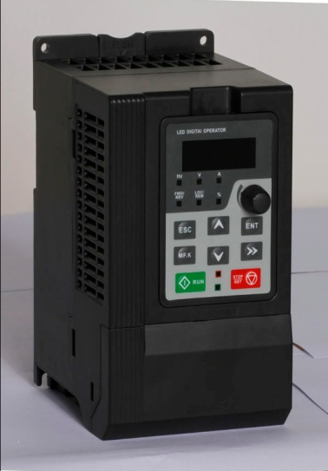
FRECON FR200L Series Introduction
Designed for wire drawing machine, based on the core control arithmetic of FR200 vector control inverter, combined with the control requirements of wire drawing machine application
Power: Three phase 380V, 0.75KW~132KW
Multi Purpose Device
Rich special application macro
Applied to water tank wire drawing machine host & winding machine, straight line type drawing machine, unwinding frame
Select application macro base on different devices and solutions to reduce parameter adjustment
Starting at any position, not break wire
System can start up at any position of balance bar
Compact structure
Compact design, paralleled installation
Constant Tension
Tension balance bar always keeps in centre of the balance bar in any case
Support DIN-Rail Mounting

Slide 11


FRECON Solution & Application
Water tank wire drawing machine
Water tank
Tension frame
Operation panel
Traversing motor
Traction motor
Winding motor

Slide 12
Principle of water tank wire drawing machine
The host drives cone pulley, the think wire pulled into thin wire after the moulds
The tension convert to be 0-10V signal through smart resistance connected tension bar
Winding inverter built-in roll diameter function to reduce winding speed automatically when more and more wire winded
Winding inverter maintain constant tension through tension feedback voltage and roll diameter function

Slide 13
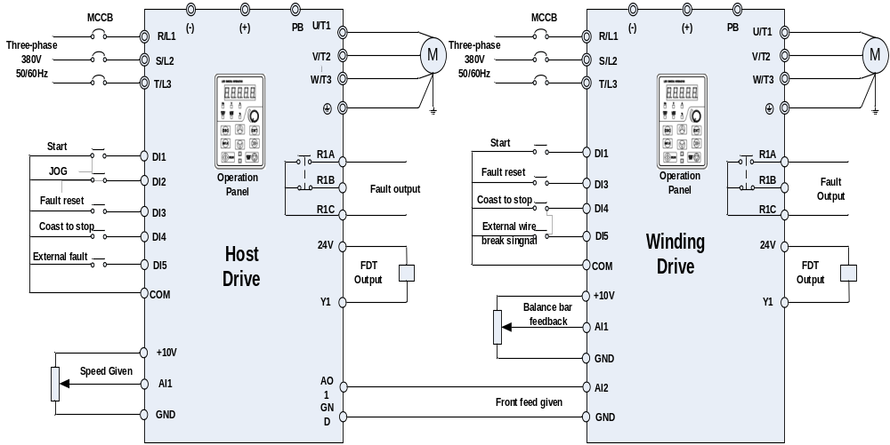
FR200L Wiring

Slide 14
Traversing motor: Simple and reliable motor
Inverter for traction motor
① Big start torque ② High speed precision ③ Stable running
Function code | Name | Recommended value
F01.01 | Master frequency command source | 2：AI1
F01.08 | Maximum frequency（Fmax) | 75.00Hz
F01.09 | Upper limit frequency (Fup) | 55.00Hz
F02.00 | Run command | 1：Terminal（LED On）
F02.02 | Reverse-proof action | 0：Reverse enabled
F02.12 | Stop mode | 0：Coast to stop
F03.00 | Accel time 1 | 40.0s
F03.01 | Decel time 1 | 40.0s
F03.08 | Jog accel time | 8.0s
F03.09 | Jog decel time | 8.0s
F04.00 | Function of terminal DI1 | 1：Running forward（FWD）
F04.01 | Function of terminal DI2 | 4：Jog forward（FJOG）
F04.02 | Function of terminal DI3 | 7：Fault reset
F04.03 | Function of terminal DI4 | 5：Jog reverse（RJOG）
F04.04 | Function of terminal DI5 | 39：Line break fault
F05.00 | Y1 output function | 2：Fault output
H00.00 | Type of wire drawing machine | 0：Host drive

Slide 15
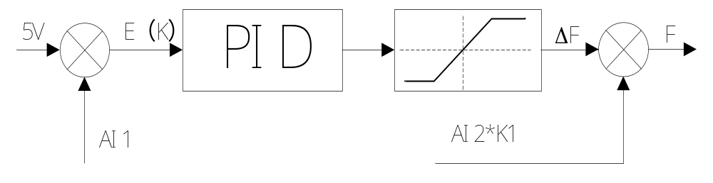
Inverter for winding motor
    Excellent PID function
    High speed precision
    Fast response
    Dynamic adjustment of PID parameters and feed forward parameters
    AI1：Tension bar feedback from inverter voltage feedback terminal
    E（K）：Difference of tension bar feedback value and 5V: 5V-AI1
    AI2：Speed value of host drive received through inverter voltage analog terminal or communication mode
    K1：Roll diameter coefficient

Slide 16
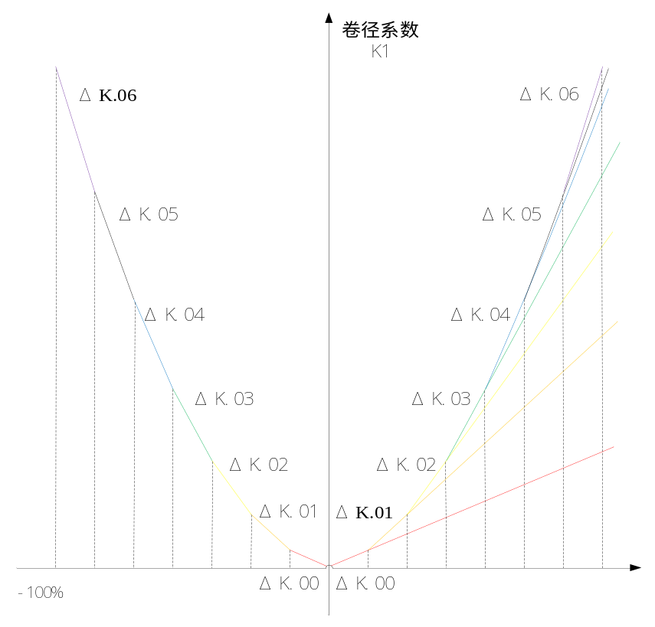
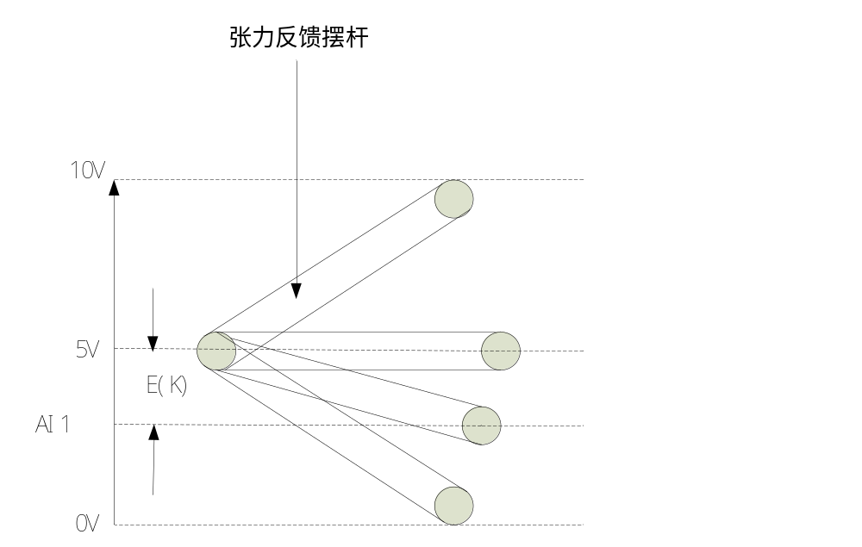
Roll diameter description
Tension bar schematic diagram:
Roll diameter coefficient
Tension feedback balance bar

Slide 17
Winding inverter parameter recommended
Function code | Name | Recommended value
F01.08 | Maximum frequency(Fmax) | 75.00Hz
F01.09 | Upper limit frequency(Fup) | 75.00Hz
F02.00 | Run command source | 1：Terminal control (LED on)
F02.02 | Reverse –proof action | 1：Reverse disabled
F02.12 | Stop mode | 0：Coast to stop
F02.14 | Stop DC braking current | 10.0%
F02.16 | Stop DC braking time | 1.5s
F03.00 | Accel time 1 | 2.0s
F03.01 | Decel time 1 | 2.0s
F03.08 | Jog accel time | 2.0s
F03.09 | Jog decel time | 2.0s
F04.00 | Function of terminal DI1 | 1：Running forward（FWD）
F04.01 | Function of terminal DI2 | 4: Jog forward （FJOG）
F04.02 | Function of terminal DI3 | 7：Fault reset
F04.03 | Function of terminal DI4 | 5：Jog reverse（RJOG）
F04.04 | Function of terminal DI5 | 39：Line break fault
F04.15 | FWD/REV terminal control mode | 2：Three-wire mode 1
F05.00 | Y1 output function | 3：Frequency-level detection（FDT1) output
F05.10 | FDT1 upper bound | 1.00Hz
F05.11 | FDT1 lower bound | 2.00Hz
H00.00 | Type of wire drawing machine | 1：Winding drive

Slide 18
Other parameter setting
H00.23 | Wire break control mode | Unit：Wire break determine mode 0：Automatic determine 1：External signal Tens：Wire break VFD statue 0：Constant running 1：Stop after the delay 2：Coast to stop | Winding:21 Unwinding:11 Straight line:21 | ×
Units：Wire break determine mode
0：Automatic determine
When feedback signal is lower than H00.26(Wire break feedback lower limit value) or bigger than H00.27(Wire break feedback upper limit value), and continue HOO.25(Running time after wire break), automatic determine is valid.
1：External signal
Digital terminal set to be 39(wire break fault),and continue H00.10, wire break is valid
Tens：Wire break VFD statue
0：Constant running
When wire break single is valid, keypad display Arn35 alarm, then continue to run
1：Stop after the delay
When wire break single is valid, keypad display Arn35 alarm, inverter continue to run with frequency setting by HOO.20, and after the time setting by H00.28, inverter decelerate to stop and report wire break fault Err35
2：Coast to stop
When wire break single is valid, report wire break fault Err35, and cost to stop
H00.26 | Wire break feedback lower limit value | 0.0%~Wire break feedback upper limit value | 5.0% | △
H00.27 | Wire break feedback upper limit value | Wire break feedback lower limit value ~100.0% | 95.0% | △
When H00.23 setting is 0, when balance bar is lower than H00.26 or bigger than H00.27, wire break timing start

Slide 19
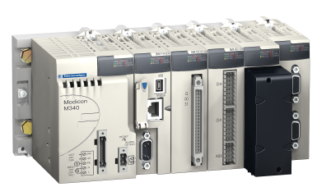
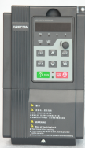
Straight line wire drawing machine
The essential difference with water tank type
Basic speed
FR200L
FR200L
FR200L
Drawing direction

Slide 20
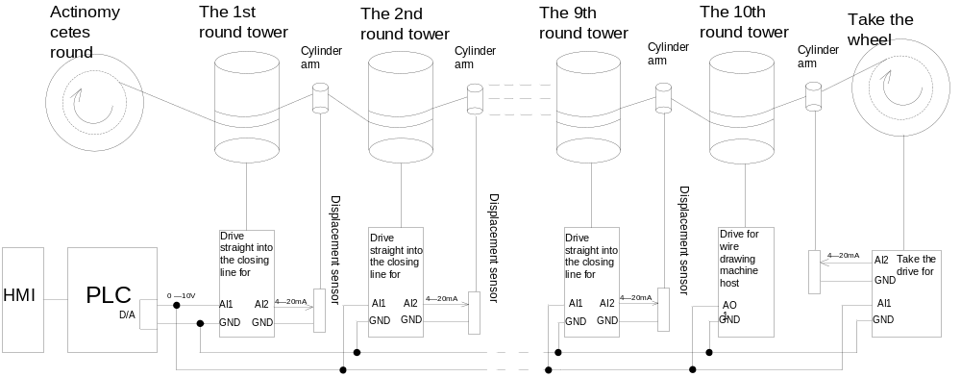
Wiring of straight line wire drawing machine

Slide 21

DRIVE THE FUTURE

